Slide 1


Enhancing the Identification of Brain Tumors Using CNN Ensemble Model
Presentation by
Supervised By
Tanjim Shifar(20-42827-1)
Mohi Uddin Anando(20-43585-1)
Rabbi Hasan Himel(20-42204-1)
Ahatesham Rabbi(19-41722-3)
Dr. S.M. Hasan Mahmud
Assistant Professor
Department of Computer Science
American International University Bangladesh

Slide 2



INTRODUCTION
Automated emotion detection systems in educational settings, utilizing techniques like facial expression recognition and body language analysis, offer the potential to enhance communication and engagement. However, challenges include monitoring diverse student reactions, distractions, and varying learning styles. Implementing such a system could improve learning environments, though current solutions for reporting emotions to teachers are lacking. Establishing an automated emotion detection system could address these issues and provide valuable insights to educators.
LITERATURE REVIEW
METHODOLOGY
Discussion
CONCLUSION
Presenting by ASHADU JAMAN SHAWON

Slide 3
INTRODUCTION
LITERATURE REVIEW
Numerous studies explore automatic facial expression analysis for various applications, such as predicting driver emotions and assessing student engagement. Researchers have focused on predicting 5 to 7 facial expressions using multimodal data, including EEG, eye tracking, and voice signals. Recent works aim to create computer vision-based emotion detection systems for students' mental health and identify exam-related misconduct. The common goal across these studies is precise emotion recognition through diverse technological approaches.
METHODOLOGY
Discussion
CONCLUSION
Presenting by ASHADU JAMAN SHAWON

Slide 4

INTRODUCTION
REVIEW BASED on the model
LITERATURE REVIEW
Convolution Neural Network
K- Nearest Neighbors
Deep Neural Network
Artificial Neural Network
Other Models
METHODOLOGY
Discussion
CONCLUSION
Presenting by ASHADU JAMAN SHAWON

Slide 5

INTRODUCTION
REVIEW BASED on the model
Papers Models Layers
[2] CNN
[3] NBd, NB, ID3, KNN
[4] FERC 2, 4-layers
[5] VGG-19, ResNet-50, Faster R-CNN 50
[6] Faster R-CNN
[7] AlexNet, GoogleNet
[8] DNN
[9] Xception-CNN
[10] CNN 5
[11] CNN
[12] EPPNN
[13] ANNs
[14] CNN, LSTM 2
LITERATURE REVIEW
METHODOLOGY
Discussion
CONCLUSION
Presenting by ASHADU JAMAN SHAWON

Slide 6
INTRODUCTION
REVIEW BASED on the model
Papers Models Layers
[15] 2
[16] CNN
[17] ANN 3
[19] CNN
[22] VGG-16, CNN
[23] VGG-16, CNN
[24] 3DCNN, XGBoost
[26] FACS
[27] Faster R- CNN
[30] CNN
LITERATURE REVIEW
METHODOLOGY
Discussion
CONCLUSION
Presenting by ASHADU JAMAN SHAWON

Slide 7
REVIEW BASED ON DATASET
INTRODUCTION
Expressions | Test Data | Train Data | Total Data
Happy | 1774 | 7215 | 8989
Angry | 958 | 3995 | 4953
Sad | 1247 | 4830 | 6077
Surprise | 831 | 3171 | 4002
disgust | 111 | 436 | 547
fear | 1024 | 4097 | 5121
Neutral | 1233 | 4965 | 6198
Total | 7178 | 28709 | 358887
LITERATURE REVIEW
METHODOLOGY
Discussion
CONCLUSION
Presenting by ANIKA TABASSUM

Slide 8
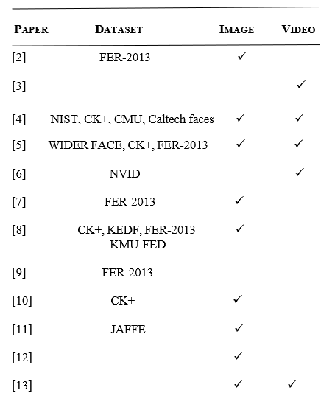
REVIEW BASED ON DATASET
INTRODUCTION
LITERATURE REVIEW
METHODOLOGY
Discussion
CONCLUSION
Presenting by ANIKA TABASSUM

Slide 9


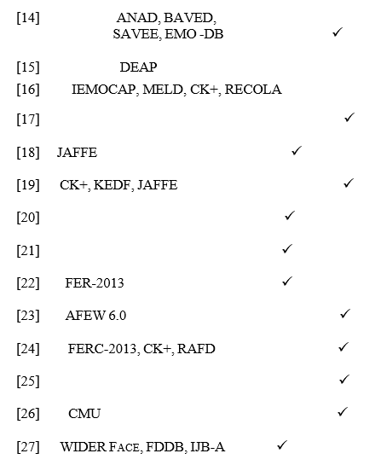
REVIEW BASED ON DATASET
INTRODUCTION
LITERATURE REVIEW
METHODOLOGY
Discussion
CONCLUSION
Presenting by ANIKA TABASSUM

Slide 10
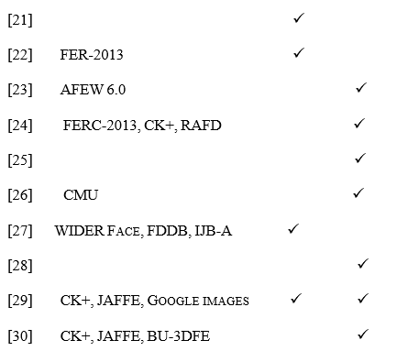
REVIEW BASED ON DATASET
INTRODUCTION
LITERATURE REVIEW
METHODOLOGY
Discussion
CONCLUSION
Presenting by ANIKA TABASSUM

Slide 11
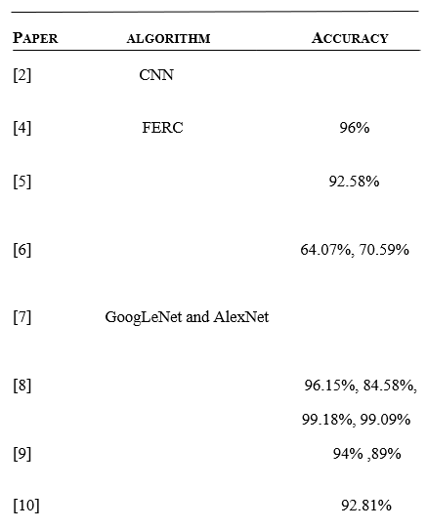
REVIEW BASED ON RESULT
INTRODUCTION
LITERATURE REVIEW
METHODOLOGY
Discussion
CONCLUSION
Presenting by ANIKA TABASSUM

Slide 12

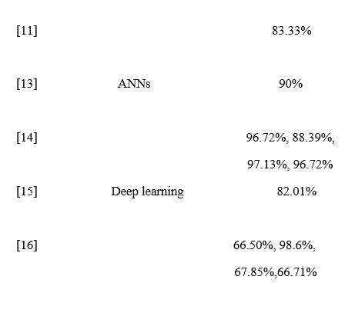
INTRODUCTION
REVIEW BASED ON RESULT
LITERATURE REVIEW
METHODOLOGY
Discussion
CONCLUSION
Presenting by ANIKA TABASSUM

Slide 13
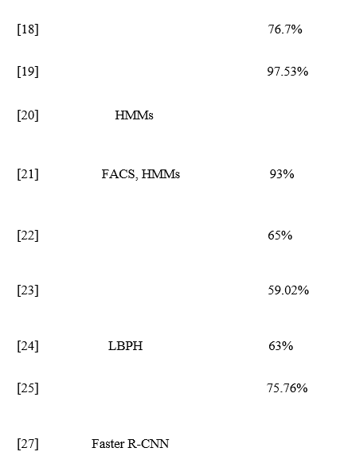
INTRODUCTION
REVIEW BASED ON RESULT
LITERATURE REVIEW
METHODOLOGY
Discussion
CONCLUSION
Presenting by ANIKA TABASSUM

Slide 14
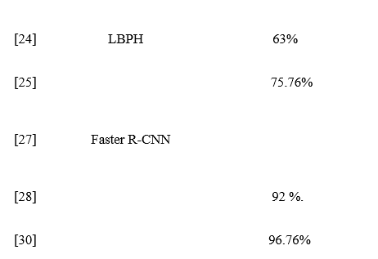
INTRODUCTION
REVIEW BASED ON RESULT
LITERATURE REVIEW
METHODOLOGY
Discussion
CONCLUSION
Presenting by ANIKA TABASSUM

Slide 15
INTRODUCTION
LITERATURE REVIEW
INTRODUCING AUTOMATED EMOTION MONITORING IN EDUCATION COULD DISTURB TEACHER-STUDENT DYNAMICS, UNDERSCORING THE NECESSITY OF COMBINING TECHNOLOGY WITH A NURTURING ENVIRONMENT TO MAINTAIN RAPPORT.
AUTOMATED EMOTION-TRACKING SYSTEMS IN CLASSROOMS RAISE PRIVACY CONCERNS, DEMANDING SOLID DATA PROTECTION TO PREVENT UNAUTHORIZED ACCESS AND MISUSE OF SENSITIVE EMOTIONAL INFORMATION.
HARMONIZING TECHNOLOGY AND THE HUMAN ASPECT IN EDUCATION, AUTOMATED EMOTION MONITORING SHOULD ASSIST, NOT REPLACE, TEACHERS IN UNDERSTANDING AND SUPPORTING STUDENTS' EMOTIONAL WELL-BEING.
AUTOMATED EMOTION MONITORING'S POTENTIAL BENEFITS AND CHALLENGES, INCLUDING CONFIDENTIALITY, ACCURACY, AND ETHICAL CONCERNS, WARRANT CAREFUL CONSIDERATION IN CLASSROOM IMPLEMENTATION.
METHODOLOGY
DISCUSSION
CONCLUSION

Slide 16

INTRODUCTION
ACTIVE PARTICIPATION AND EXAM SUCCESS: A STUDY FROM THE UNIVERSITY OF CALIFORNIA, LOS ANGELES, REVEALS THAT NOTE-TAKING AND ASKING QUESTIONS DURING LECTURES INCREASE STUDENTS' LIKELIHOOD OF PASSING EXAMS, SUGGESTING ACTIVE PARTICIPATION ENHANCES COMPREHENSION AND PERFORMANCE.
FACIAL EXPRESSION RECOGNITION METHODS: WHILE ONE APPROACH ACHIEVED 96.76% ACCURACY USING CNN IN THE CK+ DATABASE, DIFFERENT FACIAL EXPRESSION RECOGNITION METHODS SHOW COMPETITIVE FINDINGS, SHOWCASING THE POTENTIAL FOR ACCURATE EMOTION DETECTION.
REAL-TIME DRIVER MOOD DETECTION: REAL-TIME DRIVER MOOD DETECTION UTILIZES DEEP NETWORK TECHNIQUES CONSIDERING FACTORS LIKE POSITION VARIATIONS, ILLUMINATION, AND OCCLUSIONS, ACHIEVING HIGH ACCURACY RATES RANGING FROM 83.68% TO 99.18% ACROSS MULTIPLE DATASETS.
LITERATURE REVIEW
METHODOLOGY
Discussion
CONCLUSION

Slide 17
INTRODUCTION
LITERATURE REVIEW
UTILIZING DATASETS AND ALGORITHM: THE STUDY UTILIZES MAJOR DATASETS INCLUDING CK+, FER 2013, KDEF, AND KMU-FED, ALONG WITH THE CNN ALGORITHM, DEMONSTRATING THEIR POTENTIAL FOR APPLICATIONS SUCH AS STUDENT EMOTION DETECTION.
BENEFITS OF STUDENT EMOTION DETECTION: IMPLEMENTING STUDENT EMOTION DETECTION IN CLASSROOMS OFFERS ADVANTAGES FOR TEACHERS AND STUDENTS, ENABLING TARGETED INTERVENTIONS FOR STRUGGLING STUDENTS, FOSTERING A POSITIVE LEARNING ENVIRONMENT, AND ENHANCING TEACHER-STUDENT CONNECTIONS, ALTHOUGH CHALLENGES SUCH AS LIGHTING CONDITIONS AND SOCIOECONOMIC FACTORS IMPACT ACCURACY.
METHODOLOGY
Discussion
CONCLUSION

Slide 18

REFERENCES
REFERENCES 2
L. ’Zahara, P. ’Musa, E. P. ’Wibowo, I. ’Karim, and S. B. ’Musa, “The Facial Emotion Recognition (FER-2013) Dataset for Prediction System of Micro-Expressions Face Using the Convolutional Neural Network (CNN) Algorithm based Raspberry Pi”.
REFERENCES 3
Y. ’Sun, N.’ ’Sebe, M.’S. Lew, and T.’ ’Gevers, “Authentic Emotion Detection in Real-Time Video,” vol. volume 3058, 2004.
REFERENCES 4
N. ’Mehendale, “Facial emotion recognition using convolutional neural networks (FERC),” 2020.

Slide 19
REFERENCES
REFERENCES 5
S. ’Gupta, P. ’Kumar, and R.’ ’Tekchandani, “A multimodal facial cues-based engagement detection system in e-learning context using deep learning approach,” link.springer.com, Feb. 2023.
REFERENCES 6
S. ’Nayak, B. ’Nagesh, A. ’Routray, and M. ’Sarma, “A Human–Computer Interaction framework for emotion recognition through time-series thermal video sequences,” sciencedirect.com, Jun. 2021.
REFERENCES 7
P. ’Giannopoulos, I. ’Perikos, and I. ’Hatzilygeroudis, “Deep Learning Approaches for Facial Emotion Recognition: A Case Study on FER-2013,” link.springer.com, vol. volume 85.

Slide 20
REFERENCES
REFERENCES 8
B. S. ’Sukhavasi, K. ’Elleithy, A. ’El-Sayed, and A. ’Elleithy, “Deep Neural Network Approach for Pose, Illumination, and Occlusion Invariant Driver Emotion Detection,” Feb. 2022.
REFERENCES 9
R. ’Helaly, A. M. ’Hajjaji, F. ’M’Sahli, and A. ’Mtibaa, “Deep Convolution Neural Network Implementation for Emotion Recognition System,” 2021.
REFERENCES 10
Y. D’’Liliana, “Emotion recognition from facial expression using deep convolutional neural network”.

Slide 21
REFERENCES
REFERENCES 11
B. W. ’Putra and F. ’Arifin, “Real-Time Emotion Recognition System to Monitor Student’s Mood in a Classroom”.
REFERENCES 12
N. ’Intrator, D. ’Reisfeld, and Y. ’Yeshurun, “Face recognition using a hybrid supervised/unsupervised neural network,” sciencedirect.com.
REFERENCES 13
Z. J. ’Lim, J. ’Mountstephens, and J. ’Teo, “Emotion Recognition Using Eye-Tracking: Taxonomy, Review and Current Challenges,” Apr. 2020.

Slide 22
REFERENCES
REFERENCES 14
W. ’Alsabhan, “Human–Computer Interaction with a Real-Time Speech Emotion Recognition with Ensembling Techniques 1D Convolution Neural Network and Attention,” Jan. 2023.
REFERENCES 15
R. ’Sharma, B. R.’ ’Pachori, and P. ’Sircar, “Automated emotion recognition based on higher order statistics and deep learning algorithm”.
REFERENCES 16
M. ’Matsugu, K. ’Mori, Y. ’Mitari, and Y.’ ’Kaneda, “Subject independent facial expression recognition with robust face detection using a convolutional neural network,” Jun. 2003.

Slide 23
REFERENCES
REFERENCES 17
V. ’Raudonis, G. ’Dervinis, and A. ’Vilkauskas, “Evaluation of human emotion from eye motions”.
REFERENCES 18
I. ’Perikos, E. ’Ziakopoulos, and I. ’Hatzilygeroudis, “Recognizing Emotions from Facial Expressions Using Neural Network”.
REFERENCES 19
E. O.’ ’Hammoumi, F. ’Benmarrakchi, N. ’Ouherrou, E. J. ’Kafi, and E. A. ’Hore, “Emotion Recognition in E-learning Systems,” IEEE, May 2018.

Slide 24
REFERENCES
REFERENCES 20
J.’C. Hung, K.-C. ’Lin, and N.-X. ’Lai, “Recognizing learning emotion based on convolutional neural networks and transfer learning,” Aug. 2019.
REFERENCES 21
J.-J. J. ’Lien, T. ’Kanade, and J.’F. Cohn, “Subtly Different Facial Expression Recognition and Expression Intensity Estimation”.
REFERENCES 22
C. S. ’Siam, A.’ ’Faisal, N. ’Mahrab, B. A. ’Haque, and I. Md. N.’ ’Suvon, “Automated Student Review System with Computer Vision and Convolutional Neural Network”.

Slide 25
REFERENCES
REFERENCES 23
Y. ’Fan, X. ’Lu, D. ’Li, and Y. ’Liu, “Video-based emotion recognition using CNN-RNN and C3D hybrid networks,” Oct. 2016.
REFERENCES 24
J.’ ’Nishchal, S. ’Reddy, and N. P. ’Navya, “Automated Cheating Detection in Exams using Posture and Emotion Analysis,” IEEE, 2020.
REFERENCES 25
C. ’Wei, H. ’Zhang, L. ’Ye, and F. ’Meng, “A school bullying detecting algorithm based on motion recognition and speech emotion recognition,” IEEE, 2021.

Slide 26
REFERENCES
REFERENCES 26
R. ’Cowie et al., “Emotion recognition in human-computer interaction,” IEEE, Jan. 2001.
REFERENCES 27
H. ’Jiang and E. ’Learned-Miller, “Face Detection with the Faster R-CNN,” IEEE, 2017.
REFERENCES 28
S. ’Chowdhury, S. ’Nath, A. ’Dey, and A. ’Das, “Development of an Automatic Class Attendance System using CNN-based Face Recognition,” IEEE, 2020.
REFERENCES 29
K. S.’ ’Sahla and T. S. ’Kumar, “Classroom Teaching Assessment Based on Student Emotions,” link.springer.com, 2016.

Slide 27
REFERENCES
REFERENCES 30
T. A. ’Lopes, de, E. ’Aguiar, F. D. A. ’Souza, and T. ’Oliveira-Santos, “Facial expression recognition with Convolutional Neural Networks: Coping with few data and the training sample order,” link.springer.com.
REFERENCES 31
M. Sambare, “Fer-2013,” Kaggle, https://www.kaggle.com/datasets/msambare/fer2013 (accessed Aug. 20, 2023).
REFERENCES 32
D. Sena, “CK+ dataset,” Kaggle, https://www.kaggle.com/datasets/davilsena/ckdataset (accessed Aug. 18, 2023).
REFERENCES 33
M. Saad, “Wider face,” Kaggle, https://www.kaggle.com/datasets/mksaad/wider-face-a-face-detection-benchmark (accessed Aug. 20, 2023).

